Slide 1
C#
Курс лекций

Slide 2
MVVM → DLL → WPF → Курсовая работа

Slide 3
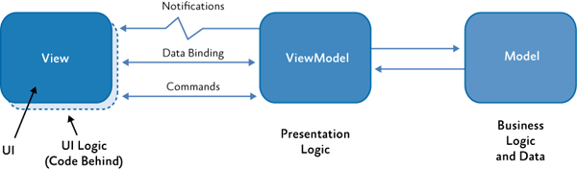
MVVM

Slide 4
MVVM Базовая реализация
INotifyPropertyChanged
IValueConverter
MarkupExtension
BindableBase
ICommand
ConvertorBase<T>
CommandBase
RelayCommand

Slide 5
INotifyPropertyChanged
public class BindableBase : INotifyPropertyChanged
{
public event PropertyChangedEventHandler PropertyChanged;
private string _sampleProperty1;
public string SampleProperty1
{
get => _sampleProperty1;
set
{
_sampleProperty1 = value;
PropertyChanged?.Invoke(this, new PropertyChangedEventArgs("SampleProperty1"));
}
}
private int _sampleProperty2;
public int SampleProperty2
{
get => _sampleProperty2;
set
{
_sampleProperty2 = value;
PropertyChanged?.Invoke(this, new PropertyChangedEventArgs("_sampleProperty2"));
}
}
}

Slide 6
INotifyPropertyChanged
public class BindableBase : INotifyPropertyChanged
{
public event PropertyChangedEventHandler PropertyChanged;
void RaisePropertyChanged(string propertyName = null) => PropertyChanged?.Invoke(this, new PropertyChangedEventArgs(propertyName));
private string _sampleProperty1;
public string SampleProperty1
{
get => _sampleProperty1;
set
{
if (Equals(_sampleProperty1, value)) return;
_sampleProperty1 = value;
RaisePropertyChanged(nameof(SampleProperty1));
}
}
private int _sampleProperty2;
public int SampleProperty2
{
get => _sampleProperty2;
set
{
if (Equals(_sampleProperty2, value)) return;
_sampleProperty2 = value;
RaisePropertyChanged(nameof(SampleProperty2));
}
}
}

Slide 7
INotifyPropertyChanged
public class BindableBase : INotifyPropertyChanged
{
public event PropertyChangedEventHandler PropertyChanged;
[NotifyPropertyChangedInvocator]
protected virtual void RaisePropertyChanged([CallerMemberName] string propertyName = null) => PropertyChanged?.Invoke(this, new PropertyChangedEventArgs(propertyName));
private string _sampleProperty1;
public string SampleProperty1
{
get => _sampleProperty1;
set
{
if (Equals(_sampleProperty1, value)) return;
_sampleProperty1 = value;
RaisePropertyChanged();
}
}
private int _sampleProperty2;
public int SampleProperty2
{
get => _sampleProperty2;
set
{
if (Equals(_sampleProperty2, value)) return;
_sampleProperty2 = value;
RaisePropertyChanged();
}
}
}

Slide 8
INotifyPropertyChanged
public class BindableBase : INotifyPropertyChanged
{
/// <summary>
/// Multicast event for property change notifications.
/// </summary>
public event PropertyChangedEventHandler PropertyChanged;
/// <summary>
/// Checks if a property already matches a desired value. Sets the property and
/// notifies listeners only when necessary.
/// </summary>
/// <typeparam name="T">Type of the property.</typeparam>
/// <param name="storage">Reference to a property with both getter and setter.</param>
/// <param name="value">Desired value for the property.</param>
/// <param name="propertyName">
/// Name of the property used to notify listeners. This value is optional and can be provided automatically when invoked from compilers that support CallerMemberName.
/// </param>
/// <returns>
/// True if the value was changed, false if the existing value matched the desired value.
/// </returns>
public bool SetProperty<T>(ref T storage, T value, [CallerMemberName] string propertyName = null)
{
if (Equals(storage, value)) return false;
storage = value;
RaisePropertyChanged(propertyName);
return true;
}
[NotifyPropertyChangedInvocator]
protected virtual void RaisePropertyChanged([CallerMemberName] string propertyName = null) => PropertyChanged?.Invoke(this, new PropertyChangedEventArgs(propertyName));
}

Slide 9
INotifyPropertyChanged
public class Bindable : BindableBase
{
private string _sampleProperty1;
public string SampleProperty1
{
get => _sampleProperty1;
set => SetProperty(ref _sampleProperty1, value);
}
private int _sampleProperty2;
public int SampleProperty2
{
get => _sampleProperty2;
set => SetProperty(ref _sampleProperty2, value);
}
}

Slide 10
MVVM
INotifyPropertyChanged
IModel
BusinessLogic
ICommand
BindableBase
Model (Data)
CommandBase
ViewModel
RelayCommand

Slide 11
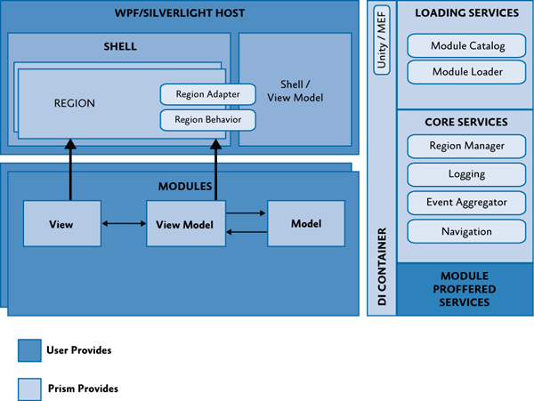
PRISM

Slide 12
XAML → CODE BEHIND → DICTIONARY → USER CONTROL→ CUSTOM CONTROL
WPF NET CORE

Slide 13
XAML
<Window x:Class="DataMiner.View.StartView"
xmlns="http://schemas.microsoft.com/winfx/2006/xaml/presentation"
xmlns:x="http://schemas.microsoft.com/winfx/2006/xaml"
xmlns:d="http://schemas.microsoft.com/expression/blend/2008"
xmlns:mc="http://schemas.openxmlformats.org/markup-compatibility/2006"
xmlns:designViewModel="clr-namespace:DataMiner.DesignViewModel"
xmlns:view="clr-namespace:DataMiner.View"
xmlns:userControls="clr-namespace:DT.DataMiner.FlowChart.UserControls;assembly=DT.DataMiner.FlowChart"
xmlns:controls1="clr-namespace:DT.DataMiner.FlowChart.Controls;assembly=DT.DataMiner.FlowChart"
mc:Ignorable="d"
Icon="../Resources/Images/magnet.png" MinHeight="300" MinWidth="600"
Style="{StaticResource WindowStyle}"
FontFamily="{StaticResource LatoRegular}"
Title="DATA MINER V.0.1" Height="450" Width="1200"
d:DataContext="{x:Static designViewModel:DesignStartViewModel.Instance}">
<Window.InputBindings>
<KeyBinding Key="Delete" Command="{Binding RemoveSelectedCommand}"/>
<KeyBinding Key="A" Modifiers="Control" Command="{Binding SelectAllItemsCommand}"/>
</Window.InputBindings>
<Grid>
<Grid.RowDefinitions>
<RowDefinition Height="Auto"/>
<RowDefinition/>
</Grid.RowDefinitions>
<Grid.ColumnDefinitions>
<ColumnDefinition Width="Auto" MinWidth="50"/>
<ColumnDefinition Width="Auto"/>
<ColumnDefinition/>
</Grid.ColumnDefinitions>
<userControls:DiagramControl Grid.Column="2" Grid.Row="1"/>
<Grid Grid.Column="0" Grid.Row="1">
<StackPanel>
<view:ToolBoxControlView DataContext="{Binding OpcControlViewModel}" Width="120"/>
<view:ToolBoxControlView DataContext="{Binding FirstControlViewModel}" Width="120"/>
<view:ToolBoxControlView DataContext="{Binding SecondControlViewModel}" Width="120"/>
</StackPanel>
</Grid>
<Separator VerticalAlignment="Stretch" Width="5" Background="Transparent" Grid.Column="1" Grid.Row="1"/>
<controls1:BlueprintToolbar Grid.Row="0" Grid.Column="0" Grid.ColumnSpan="3"/>
</Grid>
</Window>

Slide 14
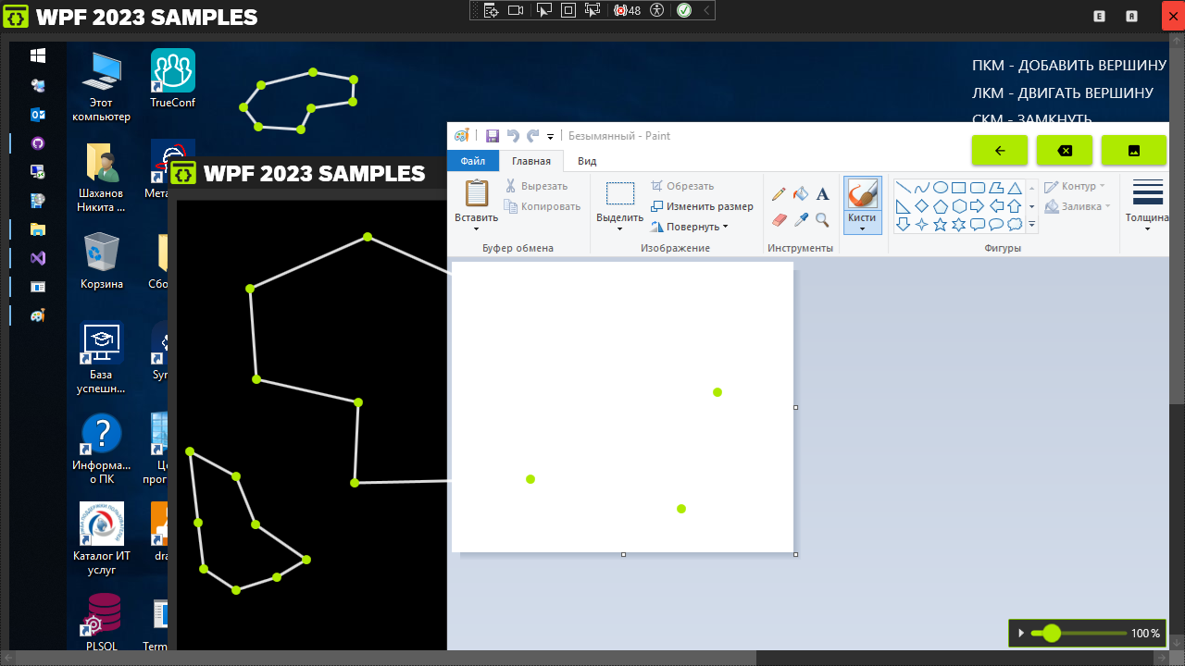
XAML КОНСТРУКТОР

Slide 15
CODE BEHIND
using System.Windows;
namespace DataMiner.View
{
/// <summary>
/// Логика взаимодействия для MainWindow.xaml
/// </summary>
public partial class StartView : Window
{
public StartView()
{
InitializeComponent();
}
}
}

Slide 16
Словари ресурсов
<ResourceDictionary x:Class="Themes.Metro.Dark.Themes.VS2012.WindowStyle"
xmlns="http://schemas.microsoft.com/winfx/2006/xaml/presentation"
xmlns:x="http://schemas.microsoft.com/winfx/2006/xaml"
xmlns:converters="clr-namespace:Themes.Metro.Dark.Converters"
xmlns:vs2012="clr-namespace:Themes.Metro.Dark.Themes.VS2012">
<ResourceDictionary.MergedDictionaries>
<ResourceDictionary Source="../MetroTheme/Theme.Colors.New.xaml"/>
</ResourceDictionary.MergedDictionaries>
<SolidColorBrush x:Key="TitleBarBackgroundBrush" Color="#FF282828" />
<SolidColorBrush x:Key="WindowBorderBrush" Color="#007ACC" />
<SolidColorBrush x:Key="WindowBorderBrushInactive" Color="#999999" />
<SolidColorBrush x:Key="WindowStatusForeground" Color="#FFFFFF" />
<SolidColorBrush x:Key="WindowStatusForegroundInactive" Color="#FFFFFF" />
…
</ResourceDictionary>

Slide 17
UserControl
<UserControl x:Class="DataMiner.View.OpcServerView"
xmlns="http://schemas.microsoft.com/winfx/2006/xaml/presentation"
xmlns:x="http://schemas.microsoft.com/winfx/2006/xaml"
xmlns:mc="http://schemas.openxmlformats.org/markup-compatibility/2006"
xmlns:d="http://schemas.microsoft.com/expression/blend/2008"
xmlns:local="clr-namespace:DataMiner.View"
mc:Ignorable="d"
d:DesignHeight="60" d:DesignWidth="150">
<Grid>
</Grid>
</UserControl>

Slide 18
CustomControl
/// <summary>
/// Sample
/// </summary>
public class Connector : Control
{
#region ctor
static Connector()
{
DefaultStyleKeyProperty.OverrideMetadata(typeof(Connector), new FrameworkPropertyMetadata(typeof(Connector)));
}
#endregion
}

Slide 19
DependencyProperty
#region ConnectorOrientation DependencyProperty
/// <summary>
///
/// </summary>
public ConnectorOrientation ConnectorOrientation
{
get => (ConnectorOrientation)GetValue(ConnectorOrientationProperty);
set => SetValue(ConnectorOrientationProperty, value);
}
/// <summary>
///
/// </summary>
public static readonly DependencyProperty ConnectorOrientationProperty = DependencyProperty.Register(nameof(ConnectorOrientation), typeof(ConnectorOrientation), typeof(Connector));
#endregion

Slide 20
Themes\Generic.xaml
<!-- Connector Style -->
<Style TargetType="{x:Type s:Connector}">
<Setter Property="Width" Value="10" />
<Setter Property="Height" Value="10" />
…
<Setter Property="Template">
<Setter.Value>
<ControlTemplate TargetType="{x:Type s:Connector}">
<Grid x:Name="PART_Grid" RenderTransformOrigin="0.5 0.5">
<!-- transparent extra space makes connector easier to hit -->
<Rectangle Fill="Transparent"
Margin="-2" />
<Border x:Name="PART_Data" Width="10" Height="10" CornerRadius="0 5 5 0"
Background="{TemplateBinding Background}"
BorderThickness="{TemplateBinding BorderThickness}"
BorderBrush="{TemplateBinding BorderBrush}"/>
<Path x:Name="PART_Event" Fill="{TemplateBinding Background}"
Stroke="{TemplateBinding BorderBrush}"
StrokeThickness="{TemplateBinding BorderThickness}"
Data="M0 0 H5 L10 5 L5 10 H0Z" />
<Grid.RenderTransform>
<RotateTransform x:Name="PART_RotateTransform" Angle="180" />
</Grid.RenderTransform>
</Grid>
<ControlTemplate.Triggers>
<DataTrigger Value="Left" Binding="{Binding Path=ConnectorOrientation, Mode=OneTime}">
<Setter TargetName="PART_Grid" Property="RenderTransform">
<Setter.Value><RotateTransform Angle="180" /></Setter.Value>
</Setter>
</DataTrigger>
</ControlTemplate.Triggers>
</ControlTemplate>
</Setter.Value>
</Setter>
</Style>

Slide 21
Варианты команд
№ | Стек технологий | Минимальное количество участников
1 | WPF+MVVM+PRISM + Git | 2-3 | 3,2,2,2
1.1 | WPF+MVVM+PRISM + appsettings.json + Git | 3-3 | 3,3
1.5 | ASP NET CORE + EF CORE + .txt + Git | 2-2
2 | ASP NET CORE + EF CORE + PostgreSQL(Access) + Git | 3-5 | 4,2!,4,2!,4
3 | ASP NET CORE + MVC + REST API + EF CORE + PostgreSQL(Access) + Git | 3-6+ | 7
4 | BLAZOR + MVC + REST API + EF CORE + PostgreSQL(Access) + Git | 3-6+ | 5
5 | Avalonia + MVVM + ASP NET CORE + EF CORE + PostgreSQL(Access) + Git | 3-6+ | 4
6 | WPF + MVVM + PRISM+ ASP NET CORE + EF CORE + PostgreSQL(Access) + Git | 10

